Slide 1
18.404/6.840 Lecture 6
Last time: - Proving languages not Context Free
- Turing machines
- Recognizers and deciders
- T-recognizable and T-decidable languages
Today: (Sipser §3.2 – §3.3) - Equivalence of variants of the Turing machine model
a. Multi-tape TMs
b. Nondeterministic TMs
c. Enumerators
- Church-Turing Thesis
- Notation for encodings and TMs

Slide 2


Turing machine model – review
head
a
b
a
b
b
˽
˽
. . .
Finite control
read/write input tape
On input $w$ a TM $M$ may halt (enter $q\text{acc}$ or $q\text{rej}$) or loop (run forever).
So $M$ has 3 possible outcomes for each input $w$:
Accept $w$ (enter $q\text{acc}$)
Reject $w$by halting (enter $q\text{rej}$ )
Reject $w$by looping (running forever)
$A$ is T-recognizable if $A=L(M)$ for some TM $M$.
$A$ is T-decidable if $A=L(M)$ for some TM decider $M$.
halts on all inputs
Turing machines model general-purpose computation.
Q: Why pick this model?
A: Choice of model doesn't matter. All reasonable models are equivalent in power.
Virtues of TMs: simplicity, familiarity.

Slide 3




Multi-tape Turing machines
input tape
}
Finite control
. . .
work tapes, initially blank
all tapes read/write
Theorem: $A$ is T-recognizable iff some multi-tape TM recognizes $A$
Proof: $(→)$ immediate. $(←)$ convert multi-tape to single tape:
$S$ simulates $M$ by storing the contents of multiple tapes on a single tape in “blocks”.
Record head positions with dotted symbols.
Some details of $S$:
To simulate each of $M$’s steps
Scan entire tape to find dotted symbols.
Scan again to update according to $M$’s $δ$.
Shift to add room as needed.
Accept/reject if $M$ does.
a
a
b
b
a
˽
˽
. . .
multi-tape
$$M$$
˽
. . .
1
0
1
. . .
. . .
c
c
c
a
˽
single tape
$$S$$
…
a
a
b
b
a
#
1
0
1
#
#
c
c
c
a
˽
˽

Slide 4








Nondeterministic Turing machines
A Nondeterministic TM (NTM) is similar to a Deterministic TM except for its transition function $δ: Q×Γ→𝒫( Q×Γ×$ {L, R} $)$.
Theorem: $A$ is T-recognizable iff some NTM recognizes $A$
Proof: $(→)$ immediate. $(←)$ convert NTM to Deterministic TM.
NTM
Deterministic TM
$$N$$
$$M$$
a
a
b
a
˽
˽
$$q_{8}$$
a
a
b
a
#
$$q_{3}$$
c
b
#
$$q_{7}$$
b
c
b
˽
˽
Nondeterministic computation tree
for $N$ on input $w$.
$M$ simulates $N$ by storing each thread’s tape in a separate “block” on its tape.
Also need to store the head location,
and the state for each thread, in the block.
If a thread forks, then $M$ copies the block.
If a thread accepts then $M$ accepts.
. . .
accept

Slide 5


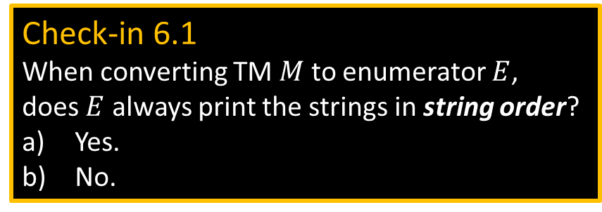


Turing Enumerators
˽
˽
˽
˽
˽
˽
˽
. . .
Finite control
read/write tape – initially blank
printer
Defn: A Turing Enumerator is a deterministic TM with a printer. It starts on a blank tape and it can print strings $w_{1 },w_{2 },w_{3 },…$ possibly going forever.
Its language is the set of all strings it prints. It is a generator, not a recognizer.
For enumerator $E$we say $L\left(E\right)=\left\{w\right| E$ prints $w\}$.
Theorem: A is T-recognizable iff $A=L(E)$ for some T-enumerator $E$.
Proof: ($←$) Convert $E$ to equivalent TM $M$.
$M=$ for input $w$:
Simulate $E$ (on blank input).
Whenever $E$ prints $x$, test $x=w$.
Accept if $=$ and continue otherwise.
Proof: ($→$) Convert TM $M$ to equivalent enumerator $E$.
$E=$ Simulate $M$ on each $w_{i}$ in $Σ^{∗}=\{ε, 0,1,00,01,10,…\}$
If $M$ accepts $w_{i}$ then print $w_{i}$ .
Continue with next $w_{i}$ .
Problem: What if $M$ on $w_{i}$ loops?
Fix: Simulate $M$ on $w_{1} ,w_{2} , …, w_{i}$ for $i$ steps, for $i=1,2,…$
Print those $w_{i}$ which are accepted.
Check-in 6.1
When converting TM $M$ to enumerator $E$, does $E$ always print the strings in string order?
Yes.
No.
Check-in 6.1

Slide 6


Slide 8
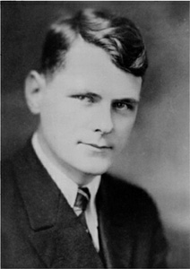
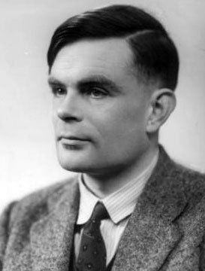
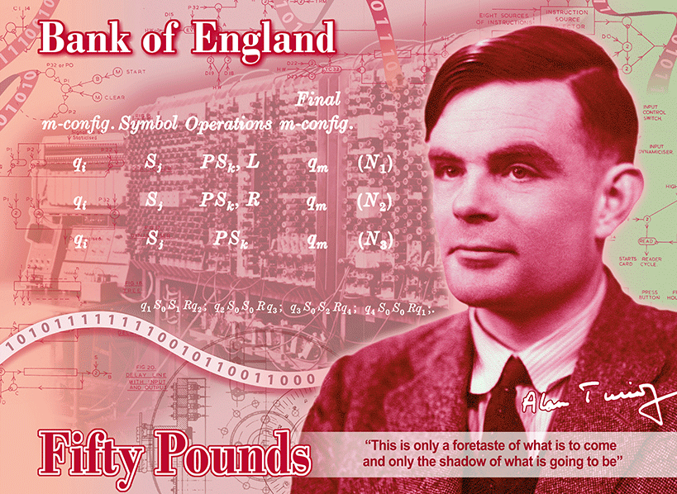

Church-Turing Thesis ~1936
=
Turing
machine
Algorithm
Intuitive
Formal
Instead of Turing machines, can use any other “reasonable” model of unrestricted computation:
$λ$-calculus, random access machine, your favorite programming language, …
Alonzo Church
1903–1995
Alan Turing
1912–1954
Will appear in 2021
Check-in 6.2
Which is the following is true about Alan Turing? Check all that apply.
Broke codes for England during WW2.
Worked in AI.
Worked in Biology.
Was imprisoned for being gay.
Appears on a British banknote.
Big impact on mathematics.
Check-in 6.2

Slide 9
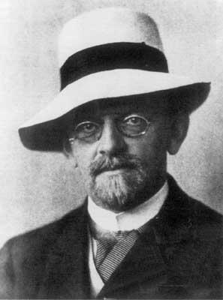

Hilbert’s 10th Problem
In 1900 David Hilbert posed 23 problems
#1) Problem of the continuum ( Does set $A$ exist where $\left|ℕ\right|<\left|A\right|<|ℝ|$ ? ).
#2) Prove that the axioms of mathematics are consistent.
#10) Give an algorithm for solving Diophantine equations.
Diophantine equations:
Equations of polynomials where solutions must be integers.
Example: $3x^{2}−2xy−y^{2}z=7$ solution: $x=1, y=2, z=−2$
Let $D=\left\{p\right|$ polynomial $p\left(x_{1}, x_{2}, …, x_{k}\right)=0$ has a solution in integers)
Hilbert’s 10th problem: Give an algorithm to decide $D$.
Matiyasevich proved in 1970: $D$ is not decidable.
Note: $D$ is T-recognizable.
David Hilbert
1862—1943

Slide 10

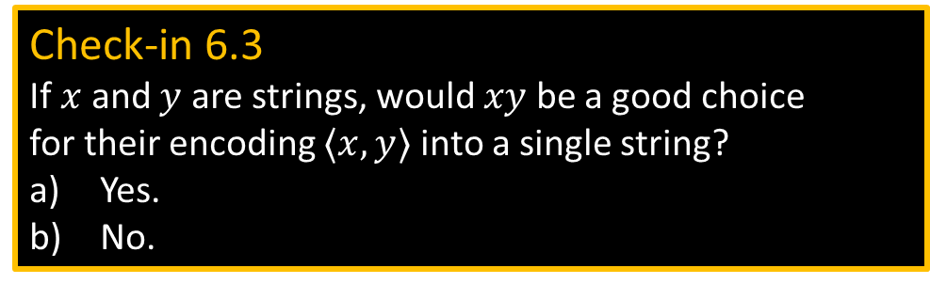
Notation for encodings and TMs
Notation for encoding objects into strings
- If $O$ is some object (e.g., polynomial, automaton, graph, etc.), we write $〈O〉$ to be an encoding of that object into a string.
- If $O_{1}, O_{2}, …, O_{k}$ is a list of objects then we write $〈O_{1}, O_{2}, …, O_{k}〉$ to be an encoding of them together into a single string.
Notation for writing Turing machines
We will use high-level English descriptions of algorithms when we describe TMs, knowing that we could (in principle) convert those descriptions into states, transition function, etc. Our notation for writing a TM $M$ is
$M=$ “On input $w$
[English description of the algorithm]”
Check-in 6.3
If $x$ and $y$ are strings, would $xy$ be a good choice for their encoding $〈x,y〉$ into a single string?
Yes.
No.
Check-in 6.3

Slide 11

TM – example revisited
TM $M$ recognizing $B=\left\{{\text{a}}^{k}{\text{b}}^{k}{\text{c}}^{k} | k≥0\right\}$
$M=$ “On input $w$
1. Check if $w∈{\text{a}}^{∗}{\text{b}}^{∗}{\text{c}}^{∗}$, reject if not.
2. Count the number of $\text{a}$’s, b’s, and c’s in $w$.
3. Accept if all counts are equal; reject if not.”
High-level description is ok.
You do not need to manage tapes, states, etc…

Slide 12








Problem Set 2
#5) Show $C$ is T-recognizable iff there is a decidable $D$ where
$C=\left\{ x\right| ∃y 〈x,y〉∈D \}$ $x,y∈Σ^{∗}$
$〈x,y〉$ is an encoding of the pair of strings $x$ and $y$ into a single string.
Think of $D$ as a collection of pairs of strings.
$$D$$
$y$-axis
$$(x,y)$$
$C$ is a “projection” of $D$
$$C$$
$$x$$
$x$-axis

Slide 13
Quick review of today
We showed that various TM variants (multi-tape, nondeterministic, enumerator) are all equivalent to the single-tape model.
Concluded that all “reasonable” models with unrestricted memory access are equivalent.
Discussed the Church-Turing Thesis: Turing machines are equivalent to “algorithms”.
Notation for encoding objects and describing TMs.
Discussed Pset 2 Problem 5.

